Slide 1
MAIN BLOCKS
MICROCONROLLER
DC MOTORS
IR TRANSMITTER AND RECEIVER CIRCUIT
DRIVERS
REGULATORS
POWERSUPPLY

Slide 2
MICRO CONTROLLER
In this project we are using PIC 16F877A controller.
PIC 16F877A
The 40 pins make it easier to use the peripherals as the functions are spread out over the pins.
This makes it easier to decide what external devices to attach without worrying too much if there are enough pins to do the job.

Slide 3
Advantage: Each pin is only shared between two or three functions so its easier to decide what the pin function (other devices have up to 5 functions for a pin).
Note: A disadvantage of the device is that it has no internal oscillator so you will need an external crystal of other clock source.

Slide 4
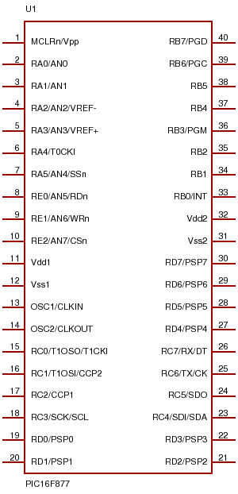

Slide 5
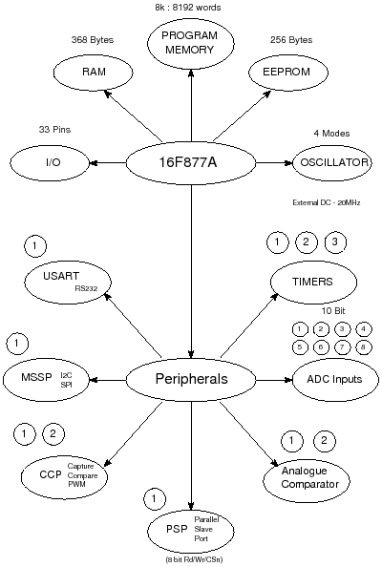

Slide 6
MOTORS & DRIVERS
We are utilising three DC motors
L293D is a typical Motor driver or Motor Driver IC which allows DC motor to drive on either direction.
L293D is a 16-pin IC which can control a set of two DC motors simultaneously in any direction.
It means that you can control two DC motor with a single L293D IC.

Slide 7
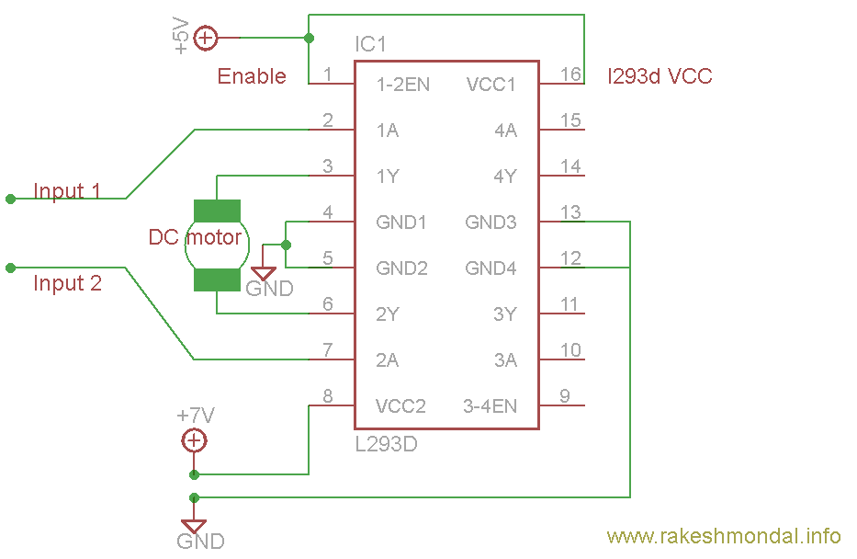

Slide 8
MOTORS & DRIVERS
It works on the concept of H-bridge.
H-bridge is a circuit which allows the voltage to be flown in either direction.
As we know voltage need to change its direction for being able to rotate the motor in clockwise or anticlockwise direction.
Hence H-bridge IC are ideal for driving a DC motor.

Slide 9
MOTORS & DRIVERS
In a single L293d chip there are two h-Bridge circuit inside the IC which can rotate two dc motor independently.
Due to its size it is very much used in robotic application for controlling DC motors. Given below is the pin diagram of a L293D motor controller.
There are two Enable pins on L293d. Pin 1 and pin 9, for being able to drive the motor, the pin 1 and 9 need to be high.
For driving the motor with left H-bridge you need to enable pin 1 to high.

Slide 10
MOTORS & DRIVERS
And for right H-Bridge you need to make the pin 9 to high. If anyone of the either pin1 or pin9 goes low then the motor in the corresponding section will suspend working. It’s like a switch.
There are 4 input pins for this L293d, pin 2,7 on the left and pin 15 ,10 on the right as shown on the pin diagram.
Left input pins will regulate the rotation of motor connected across left side and right input for motor on the right hand side.

Slide 11
MOTORS & DRIVERS
PIN2 | PIN7 | DIRECTION
LOGIC 1 | LOGIC 0 | CLOCKWISE
LOGIC 0 | LOGIC 1 | ANTI-CLOCKWISE
LOGIC 0 | LOGIC 0 | HIGH IMPEDANCE
LOGIC 1 | LOGIC 1 | IDLE

Slide 12
MOTORS & DRIVERS
The motors are rotated on the basis of the inputs provided across the input pins as LOGIC 0 or LOGIC 1.
In a very similar way the motor can also operated across input pin 15,10 for motor on the right hand side.

Slide 13
IR TRANSMITTER AND RECEIVER CIRCUIT
It is mainly used to interface to microcontroller.
Most common consumer electronic remote controls use infrared light.
They typically generate infrared using light emitting diodes (LEDs), and the main component of a receiver unit is usually a photodiode.
A remote control flashes a pattern of invisible light, which is picked up and then turned into an instruction by the receiver module.

Slide 14
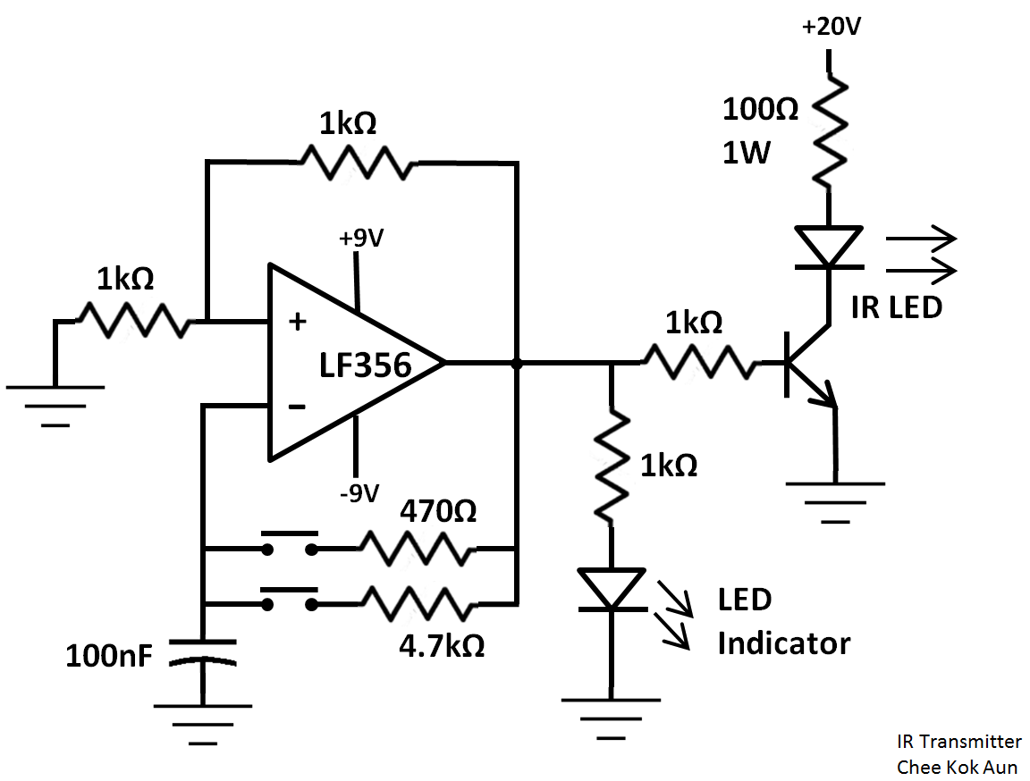

Slide 15
The parts necessary to construct transmitter and receiver are typically inexpensive, but these systems are limited to line of sight operation.

Slide 16
SPECIFICATIONS
1. Operating clock | 16Mhz
2. Regulator | 7805
3. power supply | 12v, 2 Amp
4. Body (Ball shape) | Plastic material

